Slide 1

NETFLIX MOVIE RECOMMENDATION SYSTEM
By,
Manar Abumadini

Slide 2
Overview
Dataset
8808 movies from 1890 to 2020
Contain 12 Feature
Tasks
EDA
Data Exploration
Data Cleaning
Data Visualization
Recommendation System (TF-IDF)

Slide 3
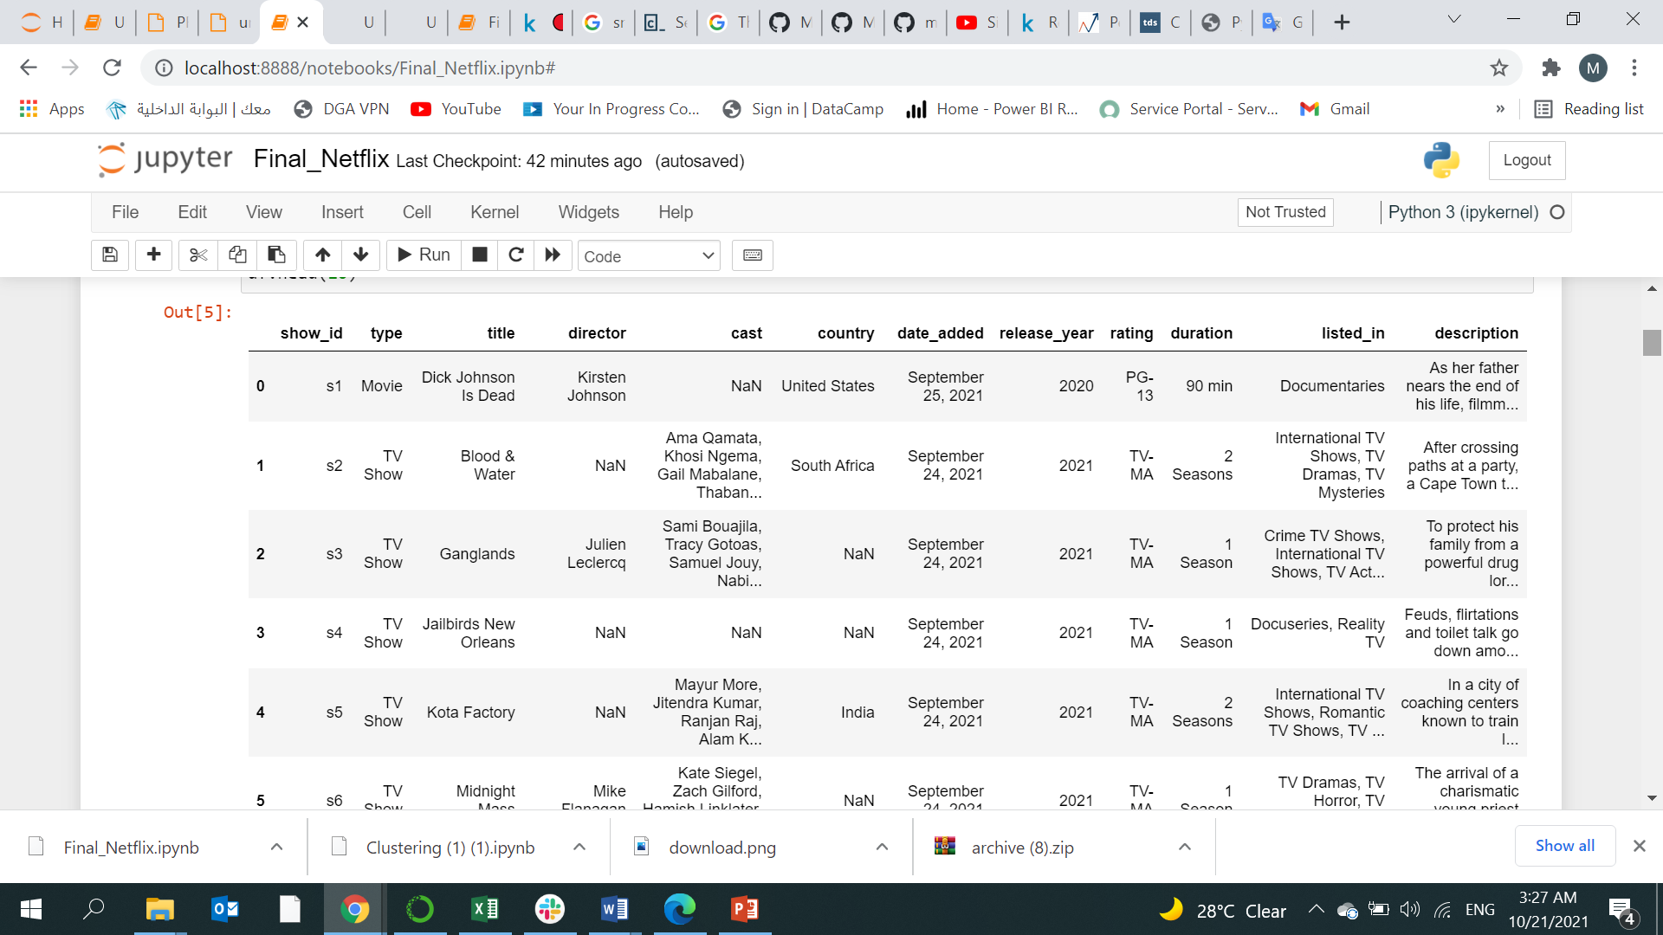
Dataset

Slide 4

PROBLEM

Slide 5
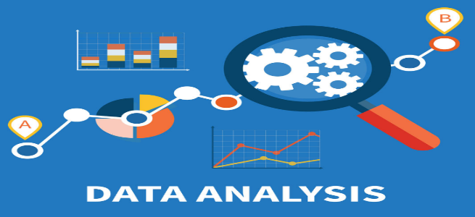
Steps :
EDA
Data Exploration
Data Cleaning

Slide 6
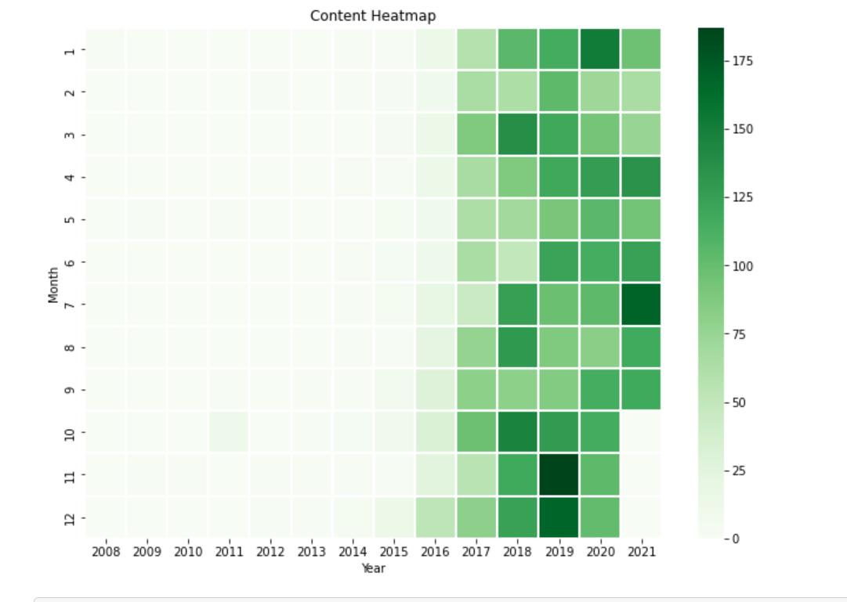
Heatmap correlation between the features

Slide 7
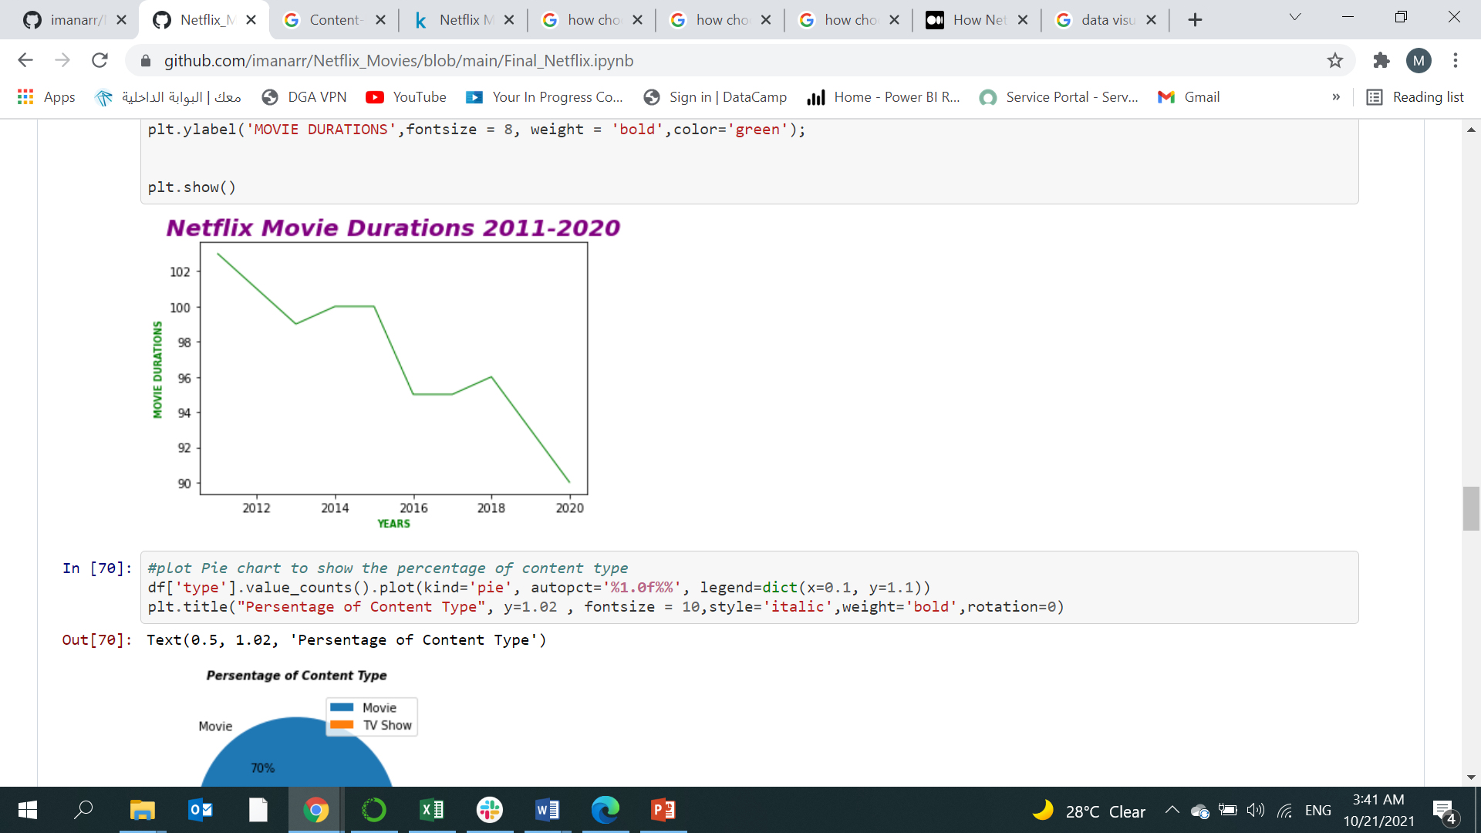
Line Chart Movie duration over years

Slide 8
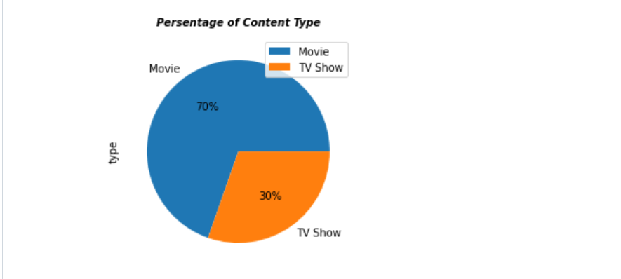
Pie Chart Pie chart to show the percentage of content type

Slide 9
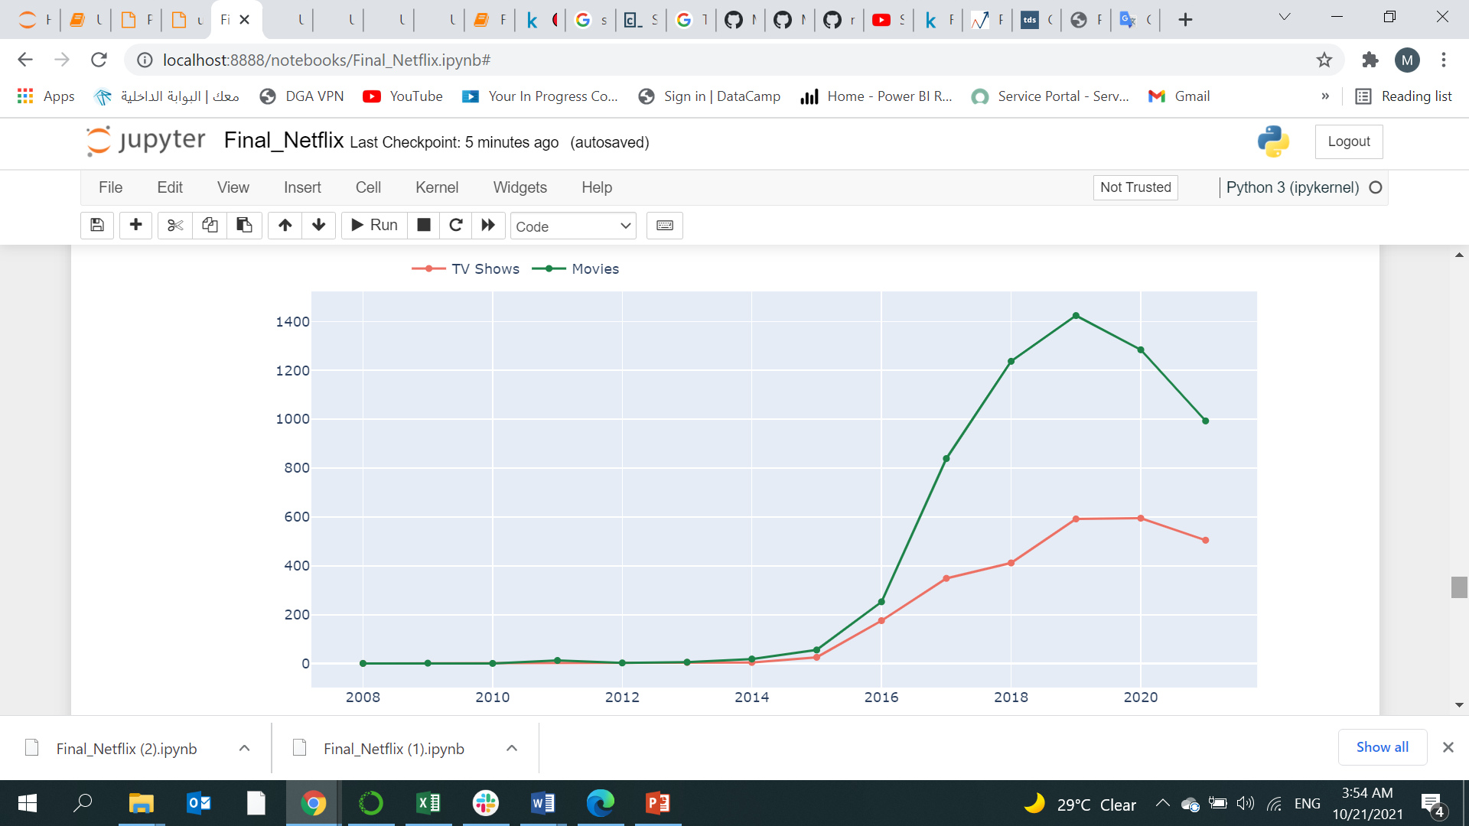
Bar Chart Bar charts of the number of Movies per Country

Slide 10
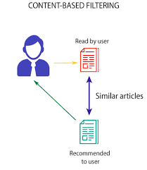
Recommendation System (TF-IDF)

Slide 11
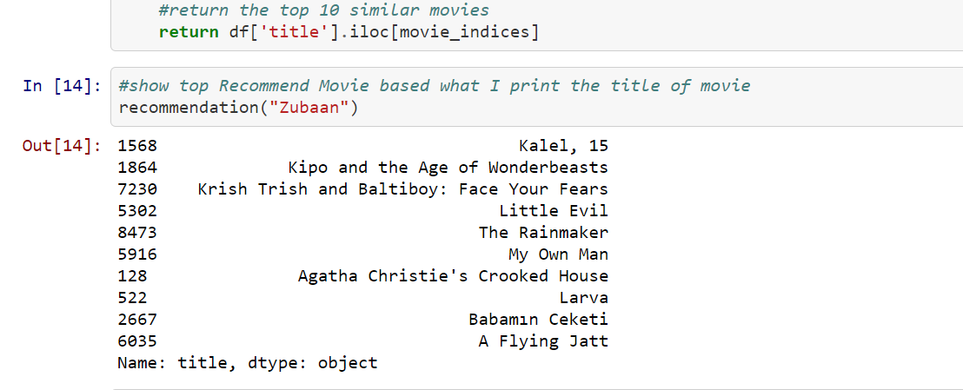
Recommendation System (TF-IDF)
Result

Slide 12
Thank you.

